Slide 1
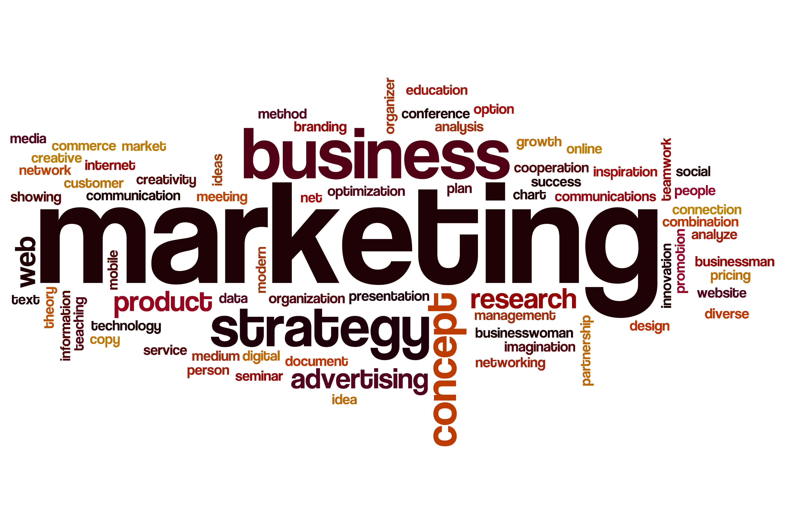

Slide 2
WHAT IS marketing?
Marketing is not only selling and advertising
Marketing is not a specialized activity at all; it encompasses the entire business
Marketing, more than any other business function, deals with customers
It is the whole biz seen from the point of view of the final result-the customer’s point of view
It is not just your product, price, promotion & distribution …
Marketing is the process by which companies engage customers, build strong customer relationships, create customer value to capture value from customer in return

Slide 3
The marketing process
Create value for customers and build customer relationships
Capture value from customers in return
Understand the marketplace & customer needs & want
Design a customer value driven marketing strategy
Construct an integrated marketing program that delivers superior value
Engage customers, build profitable relationships, & create customer delight
Capture value from customers to create profits & customer equity

Slide 4
Step 1: Understand The Marketplace & Customer Needs & Want
Customer Needs, Wants, and Demands
Needs
Discussion 1:
Do marketers create needs?
Wants
Demands
Market offerings- Products, Services, and Experiences
Products
Services
Experiences
Some sellers suffer from Marketing Myopia
The one thing that every company should ask themselves is What business are we really in?

Slide 5
Step 1: Understand The Marketplace & Customer Needs & Want
Customer Value: a central marketing concept, primarily a combination of quality, service and price (qsp), the customer value triad.
Segmentation, Target markets, and Positioning
Markets: Set of all potential clients/customers/consumers.
Consumer, Business, Global, Nonprofit and Government
Competition
Marketing environment
Supply chain

Slide 6
Step 2: Design a customer value driven marketing strategy
What customers will we serve?
How can we serve them best?

Slide 7
Marketing management orientations
The production concept
The product concept
Starting point
Focus
Means
Ends
The selling concept
Factory
Existing Prod.
Selling & promotion
Profits thru sales vol.
The Marketing concept
Market
Customer needs
Integrated marketing
Thru customer satisfaction

Slide 8
Marketing management orientations
The Holistic Marketing concept
Relationship marketing: customers, employees, partners, financial community
Integrated marketing: communications, product & services, channels, price
Internal marketing: Marketing department, Senior Management, Other departments
Performance marketing: revenue, brand & customer equity, ethics, environment, social

Slide 9
Step 3: Preparing an Integrated Marketing Plan & Program
Transforming the marketing strategy into action
Blend each marketing mix tools (4P’s) into a integrated marketing program
4Ps
Product
Price
Place
Promotion

Slide 10
Step 4: Managing customer relationship & Capturing Customer Value
Customer Relationship Management (CRM)
Customer Value
Customer Satisfaction
Customer Relationship levels & tools
Customer Engagement in today’s digital & social media
Customer engagement marketing
Partner Relationship Management

Slide 11
Step 5: Capturing value from customers
Creating Customer Loyalty & Retention
Growing share of Customer
Building customer equity

Slide 12

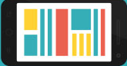

The Changing Marketing Landscape
The Digital Age:
Online marketing
Mobile marketing
Social media marketing
Rapid globalization
Sustainable marketing: The call for more environmental & social responsibility

Slide 13

Definition
Market Segmentation:
Dividing a market into distinct groups with distinct needs, characteristics, or behavior who might require separate products or marketing mixes.

Slide 14
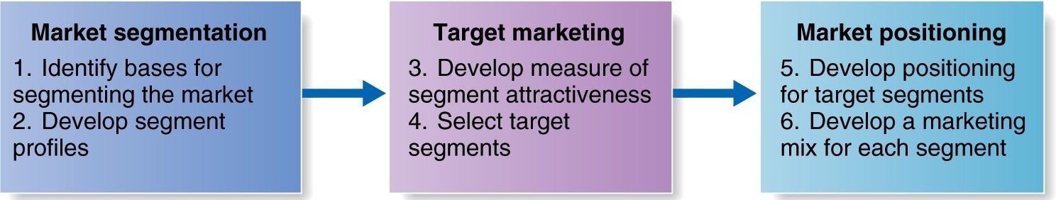
Steps in Market Segmentation, Targeting, and Positioning

Slide 15
Market Segmentation
Geographical segmentation
Demographic segmentation
Psychographic segmentation
Behavioral segmentation

Slide 16
Geographic Segmentation Variables
World Region or Country
U.S. Region
State
City
City Size
Neighborhood
Density
Climate

Slide 17
Demographic Segmentation Variables
Age
Gender
Family size
Family life cycle
Income
Race
Occupation
Education
Religion
Generation
Nationality

Slide 18
Psychographic Segmentation Variables
Lifestyle
Social class, and
Personality-based segmentation

Slide 19
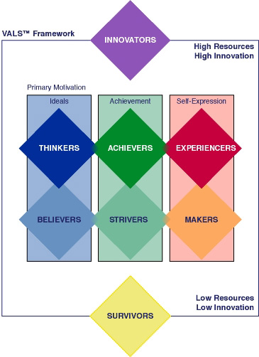
Notes:
Values Attitude and Life Style Model

Slide 20
Behavioral Segmentation Variables
Occasions
Benefits
Frequency of use
Readiness Stage
Attitude Toward the Product

Slide 21
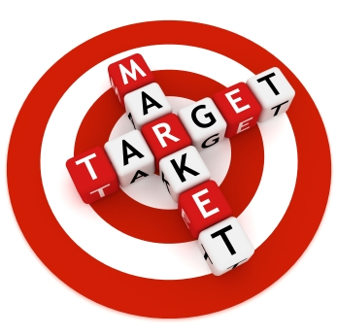
Target Marketing

Slide 22
Target Marketing
Choosing a Target Marketing Strategy Requires Consideration of:
Company resources
The degree of product variability
Product’s life-cycle stage
Market variability
Competitors’ marketing strategies

Slide 23
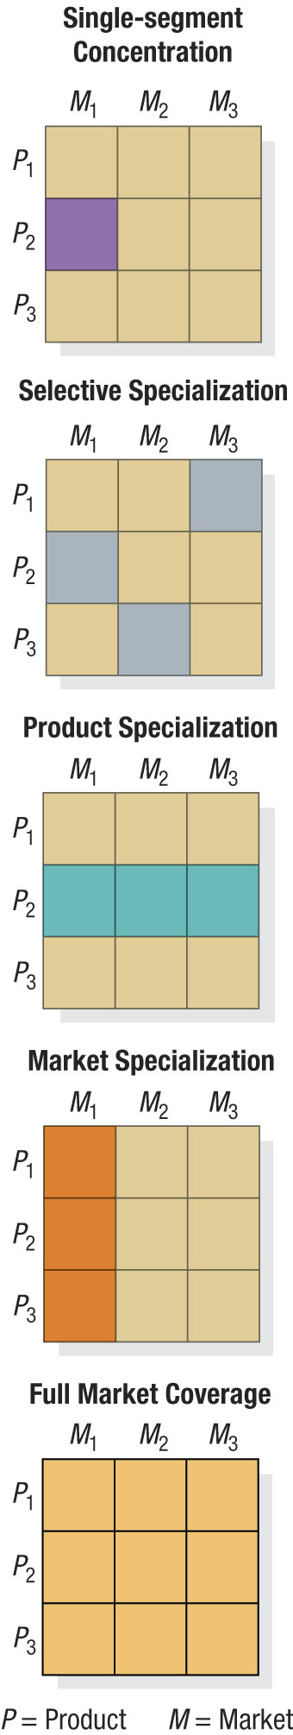
Patterns of Target Market Selection: Product x Market Matrices

Slide 24


Slide 25
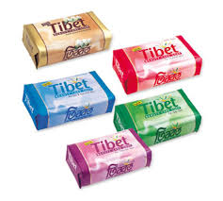
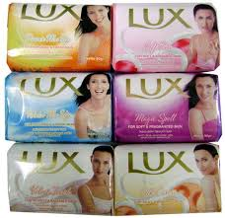
Beauty soap

Slide 26
Positioning
Is the act of designing a company’s offering and image to occupy a distinctive place in the minds of the target market.
A good brand positioning helps guide marketing strategy by clarifying the brand’s essence.
Everyone in the organization should understand the brand positioning and use it as context for marketing decisions.

Slide 27
Positioning Statement
A brief description of a product or service and target market, and
How the product or service fills a particular need of the target market.
It's meant to be used as an internal tool to align marketing efforts with the brand and value proposition.

Slide 28
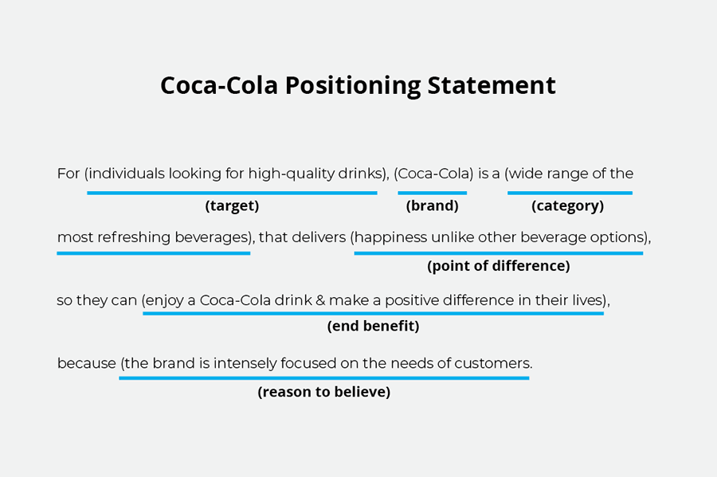

Slide 29
What is a ‘BRAND’?
Brand was a name, term, sign, symbol or design that,
Identified &
Differentiated
the products of one seller from those of another

Slide 30
What is a ‘BRAND’?
A BRAND IS MORE THAN A PRODUCT.
COMPANIES MAKE PRODUCTS BUT SELL BRANDS.
The main purpose of branding is to get more people to buy more stuff
for more years at a value price.

Slide 31
Thank you

